Slide 1
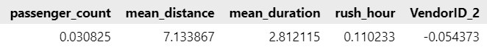
Multivariable Linear Regresion for New York City TLC Project
Executive summary report: Commission Prepared by Automatidata
The purpose of this project is to predict taxi cab fares before each ride. At this point, this project’s focus build a multivariable linear regression model to predict fare amounts.
This project objective is to build and evaluate the developed model so it can be presented and qualified as a prediction tool for the TLC comission and especially for its users.
The multivariable linear regression for fare amount was successfully developed. The model uses the scaled variables as input with its respective coeficients shown below:
Mean_distance, mean_duration variables derive from unique combinations of pick-up and drop-off locations. Rush_hour indicator derives from pick-up time. Therefore the inputs for this model are pick-up location, drop-off location, pick-up time, passenger count, and vendor ID. The inputs need to be transformed and scaled to be used in the multivariable linear regression formula.
The R2 on the test data for the model is 0.87. Results appear to be satisfactory.
Test and evaluate the model with new onfield data. TLC can create an app for this purpose
To avoid data leakage, compute the means using only the training set and copy those into the test set. It's likely some combinations of pickup-dropoff locations would only appear in the test data which needs to be addressed to have useful model input
Separate the rides that did not have rate codes of 2, train the model on that data specifically, and then add the `RatecodeID 2` data (and its imputed rates).

